Slide 1
Introduction to Programming

Slide 2
Contents
Operating Systems
Brief history of Operating Systems
File System
File Commands
cd
mkdir
mv
ls
cat
tail
less
wc

Slide 3
Contents
Processes
Process Commands
ps
kill
top
Networking
OSI Layer
TCP/IP
Networking commands
ping
nslookup / dig
Curl
ssh

Slide 4
What’s an Operating System?
First computers usually run one single process at a time
Operators had to manually update punch cards to change computer behaviour
System Operators
Computers got faster it took more time for operators to update programs
There was a need to allow computers to operate themselves
Operating System
Programs that allow to manage other programs
Interface with hardware
Drivers

Slide 5
What’s an Operating System?
Operating system is the first thing to start when the computer is turned on
Subsequently all other programs are launched by the OS
Interfacing with early peripherals (such as the first printers) was very low level requiring programmers to know every detail
Programmers didn’t had all possible peripherals to test on them their software
Operating Systems created to provide API between programs and peripherals
Device Drivers
Programmers to integrate with I/O devices

Slide 6
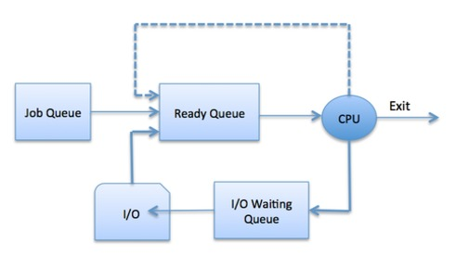
What’s an Operating System?
Programmers could call higher function calls
print()
Operating system knows how to integrate this with the I/O device (example printer or screen)
Use of several programs at the same time on a single CPU - Multitasking
Scheduler
Waiting for I/O → Slow calls to external devices

Slide 7
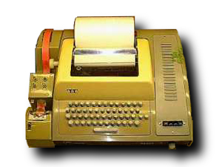
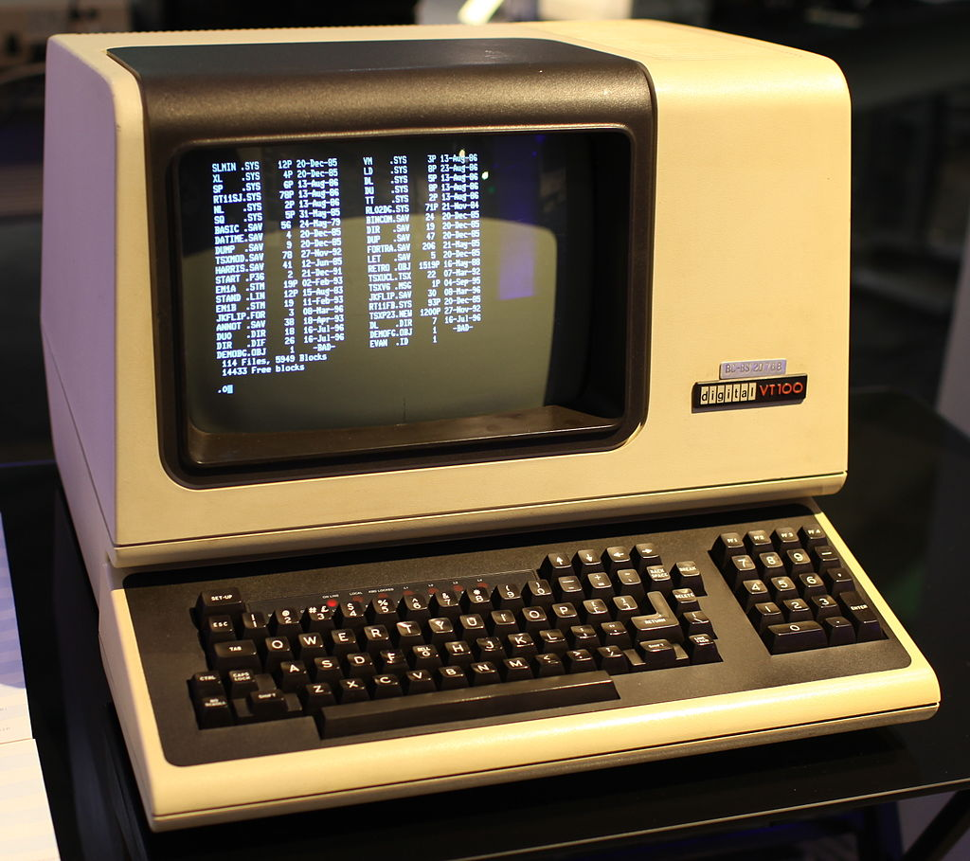
What’s an Operating System?
Each program needs its own memory
OS allocates each program its own block of memory
Virtual Memory
Each program thinks its memory as if it starts at addr 0
Memory Protection
Each programs only have access to its block of memory
Terminal
Screen and keyboard connected to computer

Slide 8
What’s an Operating System?

Slide 9
What’s an Operating System?
Several users on a computer
Time-sharing
Each user allowed to use a fraction of the time of the computer
Multics (OS) 1969
Multiplexed Information and Computing Service
Influential early time-sharing operating system
Based on the concept of a single-level memory
All modern OS were influenced by multics
One of the main problems on its commercial success it was too complex and over-engineered

Slide 10
Modern Operating Systems
Unix
1970s
Bell Labs
Dennis Ritchie and Ken Thompson
Idea Separate OS in two parts
Core functionality of the OS (Kernel)
Memory management
Multitasking
I/O
Tools bundled with the kernel but not part of it
Libraries
Programs
Kernel panic
Kernel crashes with unrecoverable error

Slide 11
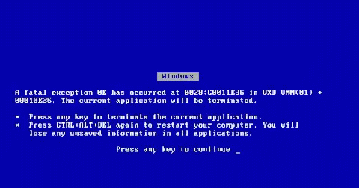
Modern Operating Systems
MS-DOS
1981
Microsoft
Lack strong memory protection

Slide 12
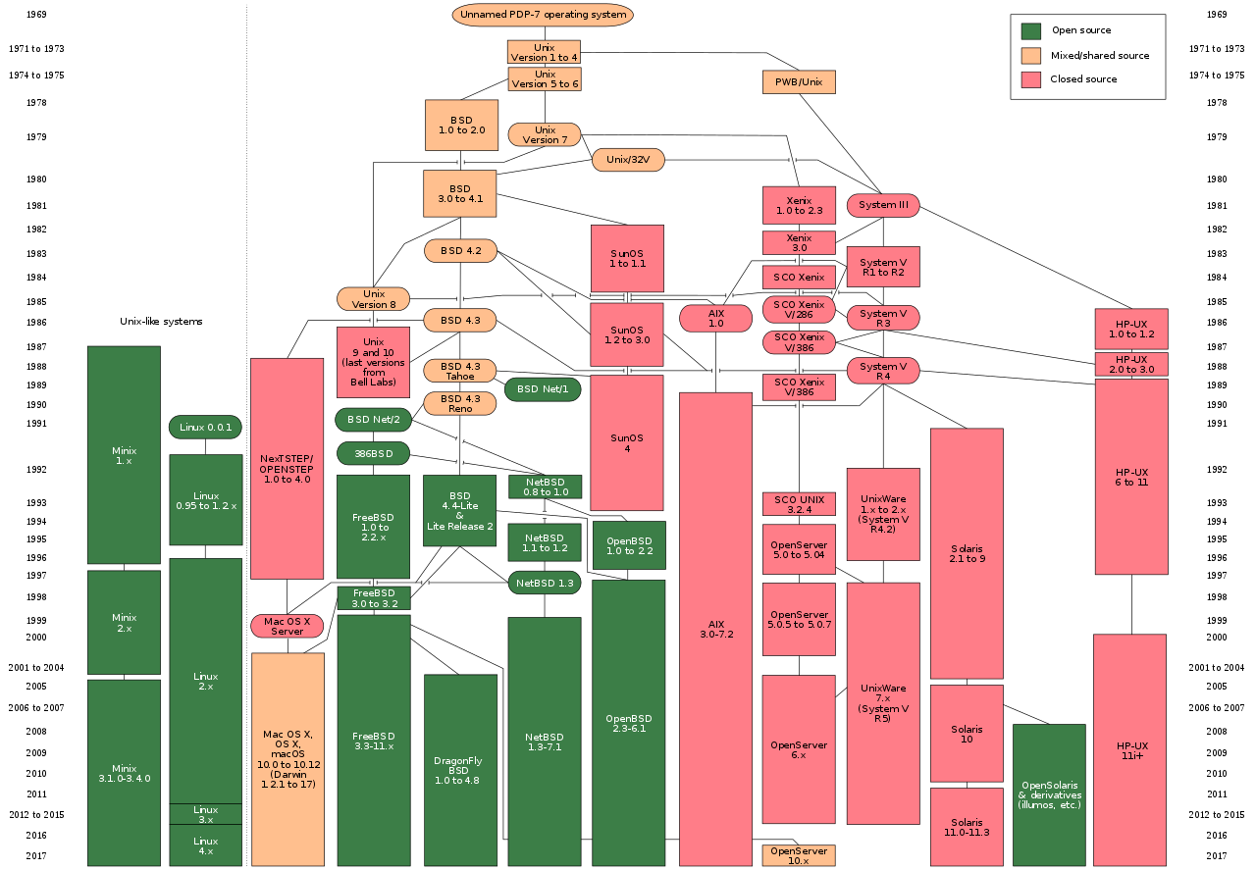
Modern Operating Systems

Slide 13


Modern Operating Systems
GNU
GNU is Not Unix
1983
Richard Stallman
Free Software
Freedom to investigate and change
Free Software Foundation (1985)
GNU General Public License (GPL)
Minix
Created at a university
Linux
1991
Linus Torvalds wanted to add features to Minix but wasn’t allowed
Decided to create a new Operating System under GPL

Slide 14
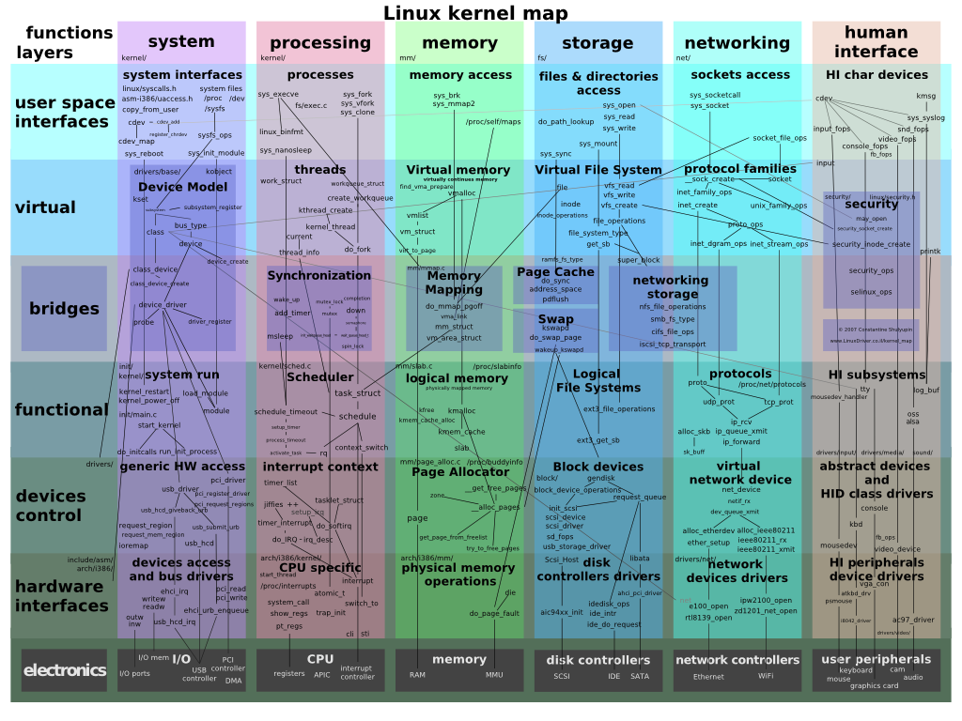
Linux

Slide 15
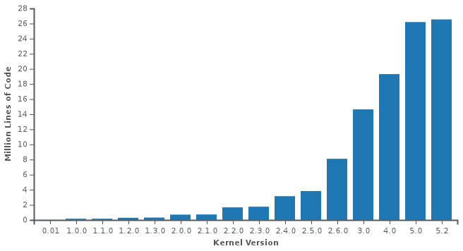
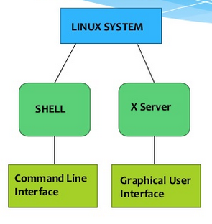
Linux
Generally two Operable modes
CLI
Command Line Interface
Provided by the Shell
GUI
Graphical User Interface
Provided by the X server

Slide 16
Linux
Distributions
Debian
Ubuntu
Red Hat
Enterprise
ArchLinux
Rolling updates
Gentoo
Hundreds of Linux Operating Systems with many developed for special purposes
Embedded: i.e. Android
Desktop
Server

Slide 17
Unix Filesystem
A Filesystem is a way of organising files
Windows
C:/
D:/
Unix
/
/home
/dev
/etc

Slide 18
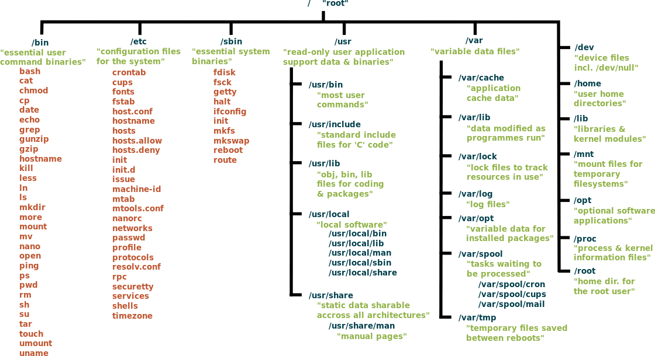
Unix Filesystem

Slide 19
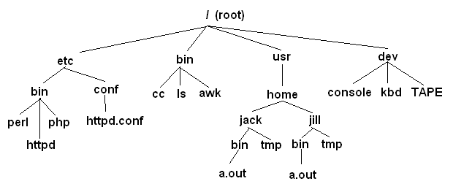
Unix Filesystem

Slide 20
Unix Filesystem
Permissions
User
Root user
group
rwx

Slide 21
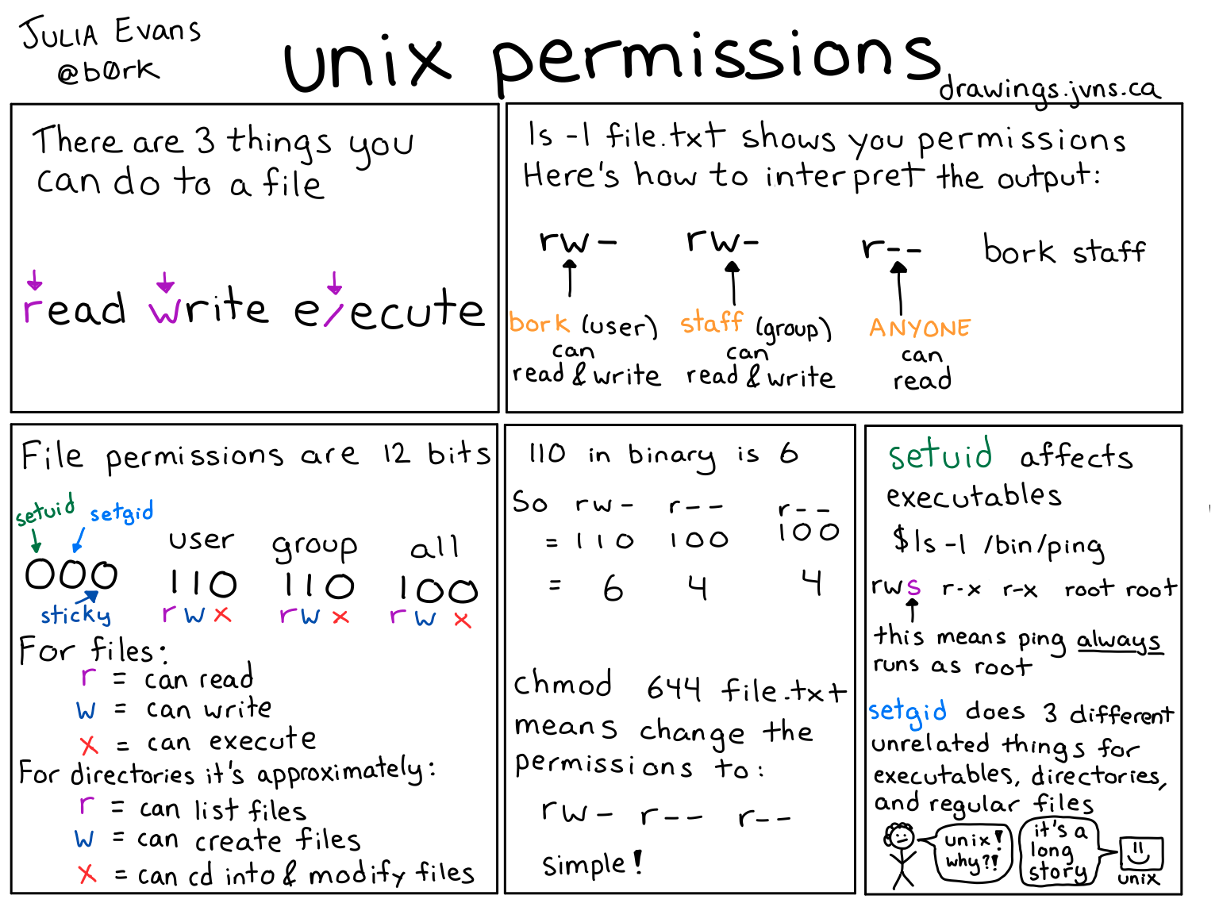
Unix Filesystem
Permissions
User
Root user
group
rwx

Slide 22
Help Command
man
This is the command used to show the manual pages. Is useful to see information about commands and information about flags to use them.
Terminal man man

Slide 23
Help Command
pwd
This command prints the current directory where we are
Terminal man pwd

Slide 24
File Commands
cd
The cd command allows us to change directories
man cd

Slide 25
File Commands
mkdir
The mkdir command creates a directory
man mkdir

Slide 26
File Commands
rmdir
The rmdir command removes a directory
man rmdir

Slide 27
File Commands
mv
The mv command allows us to move a file
man mv

Slide 28
File Commands
ls
The command is used to list the contents of a folder
Usually used with other flags
One common usage is:
ls -lrt
This specific flags list more data, order by time, putting the latest modified file/folder at the bottom
Terminal man ls

Slide 29
File Commands
cat
Main command used to see the content of a file
Terminal man cat

Slide 30
File Commands
tail
Used to read a file from the bottom
When used with the flag (-f) it shows on the screen the files while they are appended to the file
We can see the stream of data being written in the file
Terminal man tail

Slide 31
File Commands
less
Used to read a file
Terminal man less

Slide 32
File Commands
wc
Useful command to count the lines of a file
Usage: wc -l file_name
Terminal man wc

Slide 33
File Commands
chown
The chown command is used to change the owner of a file or directory
Usually used to change something from our user to root or viceversa
Terminal man chown

Slide 34
File Commands
chmod
The command chmod allows us to change the permissions of a file
Remember file permissions are rwx (read/write/execute)
The rwx are represented with bits
Terminal man chmod

Slide 35
File Commands
rm
The command rm removes a file
Usage: rm filename
Terminal man rm

Slide 36
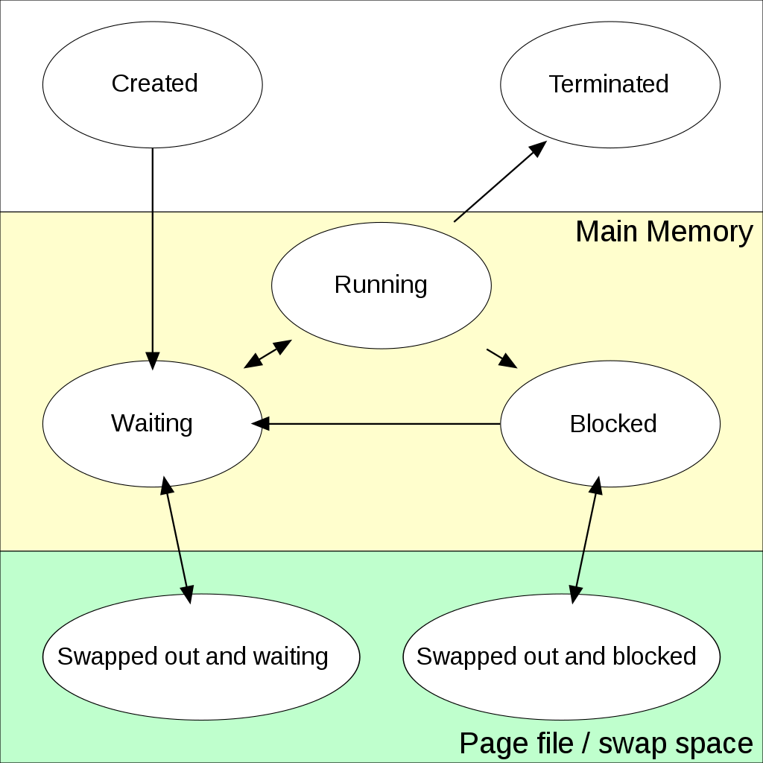
Unix Processes
Instance of a computer program that is being executed by one or many threads
/proc

Slide 37
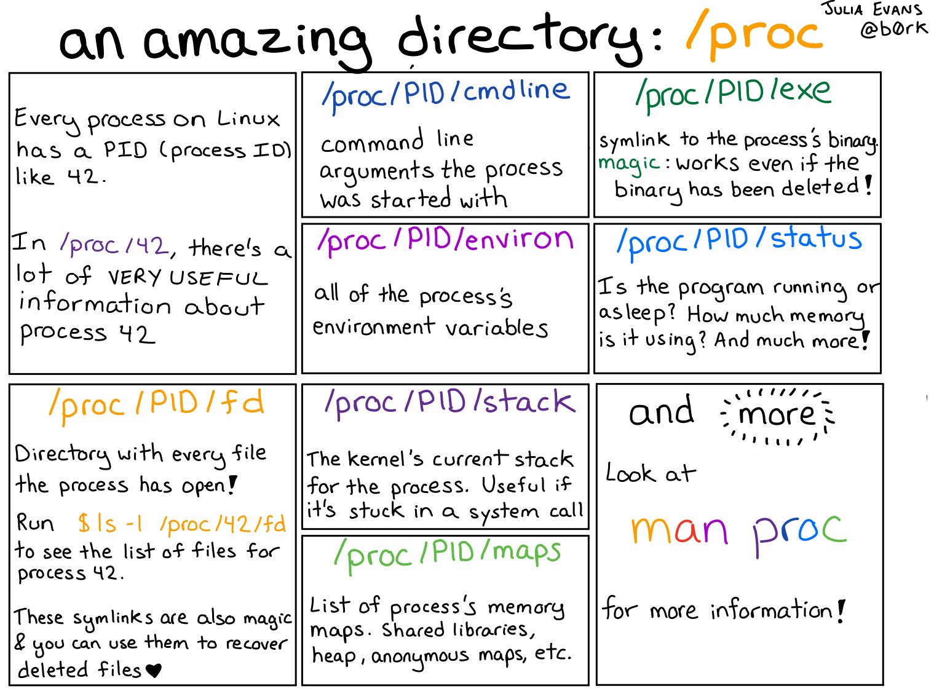
Unix Processes
Instance ofa computer program that is being executed by one or many threads
/proc

Slide 38
Process Commands
ps
The ps command lists all the processes and we can see what is their process id (PID).
The process ID is needed to be able to kill a process
Terminal man ps

Slide 39
Process Commands
kill
Terminates a process
We can send different signals to the process but the most common one in order to stop it is SIGKILL
We send the signal with:
kill -9 process_id
Terminal man kill

Slide 40
Process Commands
top
Allows us to know the status of the machine
Shows resources used by the different processes
Memory
CPU
We can see if a process is stuck or is doing some work
Terminal man top

Slide 41
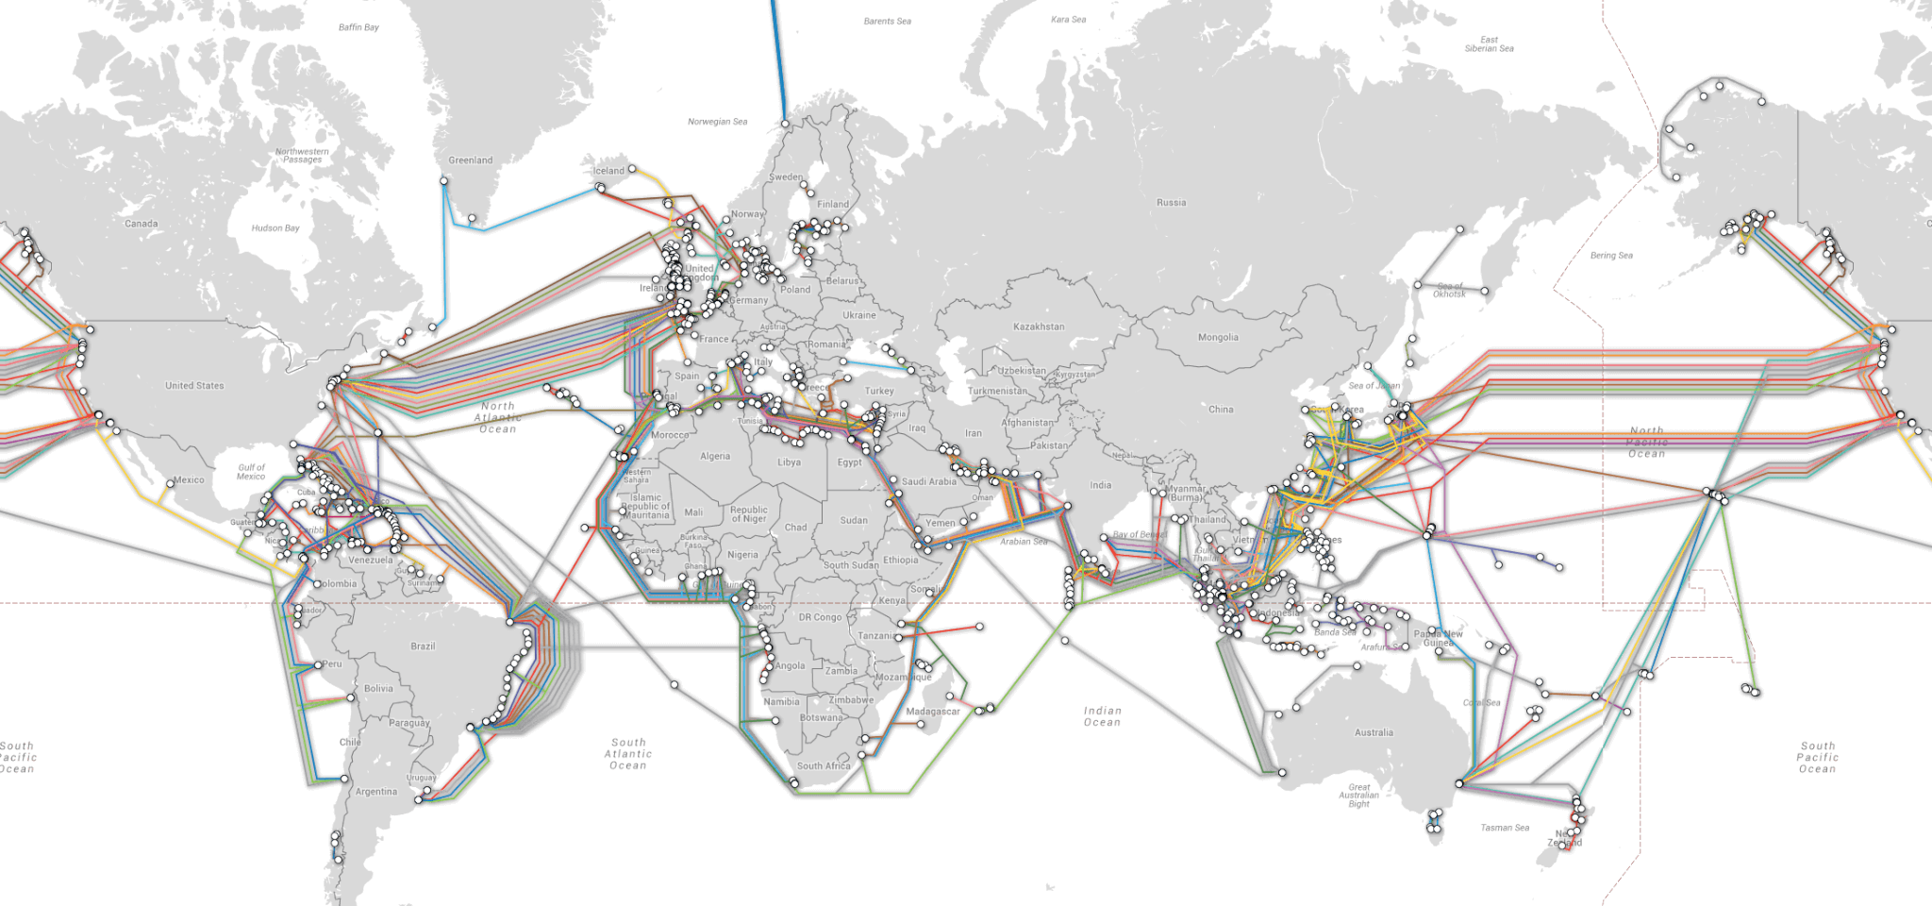
Networking & Internet

Slide 42
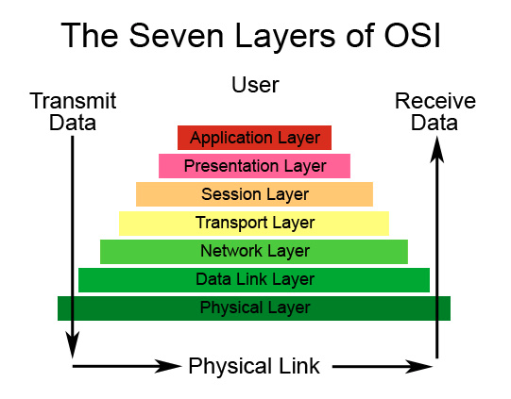
Networking
Networking
How computers interacts between each other

Slide 43
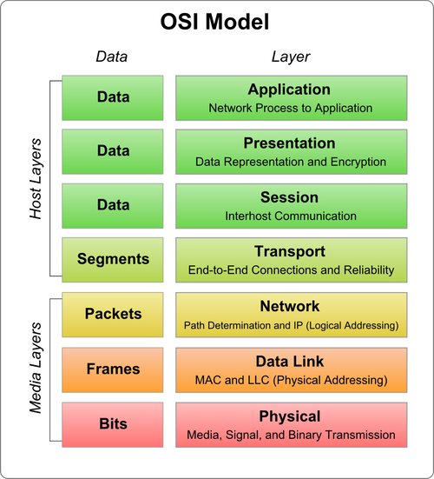
Networking

Slide 44
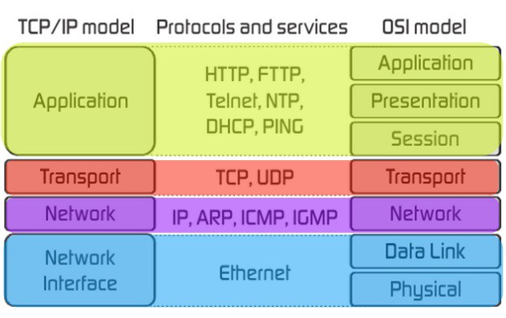
Networking
TCP/IP model

Slide 45
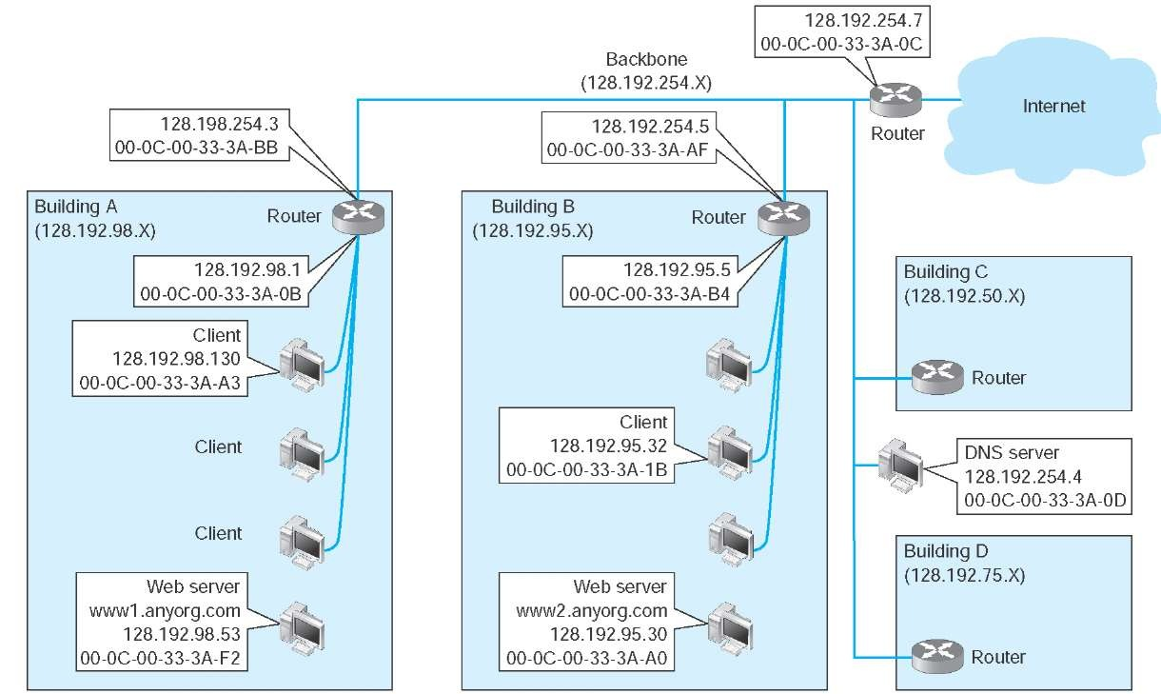
Networking
IP Address
IPv4
32 bit number identifying on a network
192.168.1.1
IPv6
128 bit number
2001:db8:0:1234:0:567:8:1

Slide 46
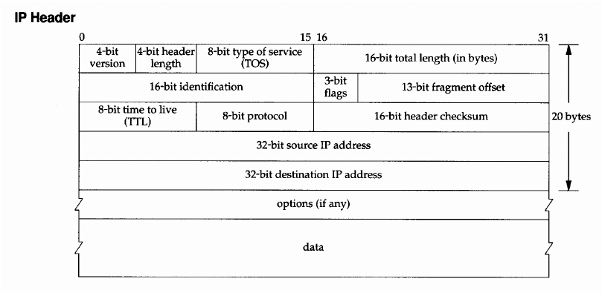
Networking
IP Packet

Slide 47
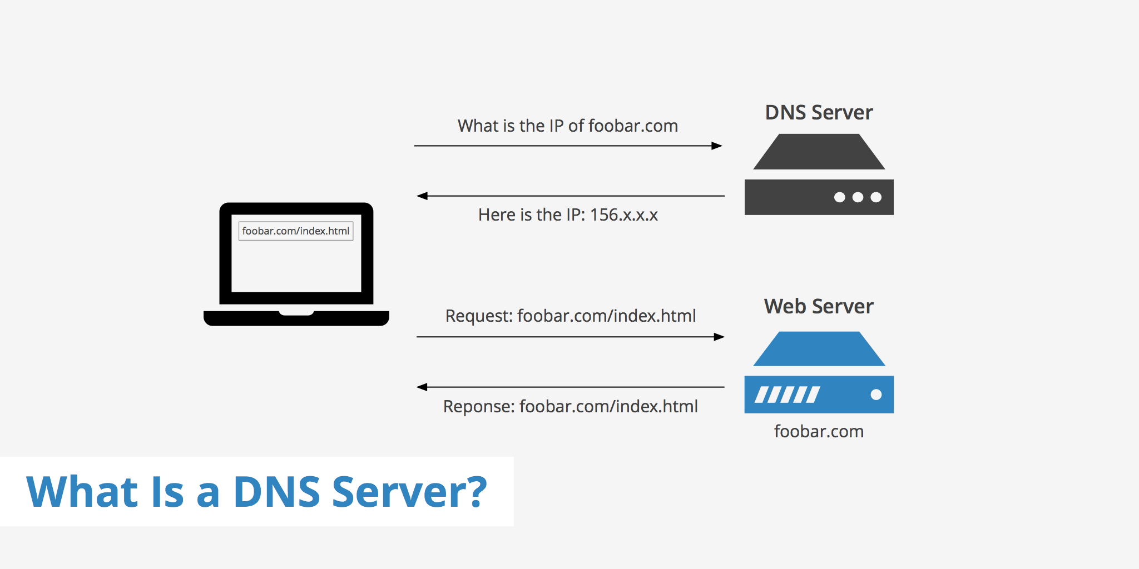
Networking
DNS
hostname

Slide 48
Network Commands
ping
Ping is a tool that allow us to send a network packet to another host and see whether the host is responding or not.
We can check connectivity with it.
Terminal man ping

Slide 49
Network Commands
Nslookup
It allows us to make DNS resolutions
From a hostname (google.com) to an IP
Terminal man nslookup

Slide 50
Network Commands
Curl
Allows us to make HTTP or HTTPS requests from the command line
Really useful to make requests to API to download documents
Terminal man curl

Slide 51


